Slide 1
Reading user Input(values) from the Console. Scanner
Sometimes you want your Program to ask you to input a value.
You should create a SCANNER object.
First you should put import java.util.Scanner at the top of your program .This way you are calling the library to be able to use the scanner object.
Then Create a Scanner object :
Scanner input = new Scanner(System.in);
the word input can be anything, it’s a variable.

Slide 2
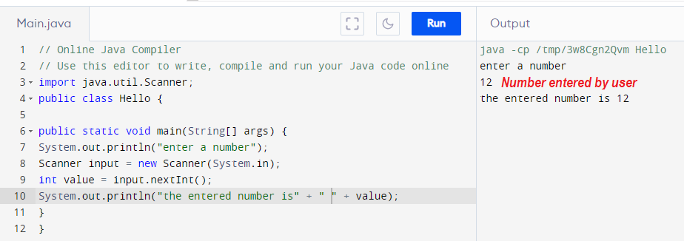
Reading user Input(values) from the Console. Scanner
Line 3 : import the library where scanner objects resides.
Line 4 : declare a class and name it Hello.
Line 6 : declare the Main method.
Line 7 : tell the program to print “enter a number”
Line 8 : declare a scanner object and call it input (the prog will take a value entered by the user)
Line 9 : declare an integer and call it value.The input object will nowbe put inside value.
Line 10 : tell the program to print “the number entered is” and value.

Slide 3
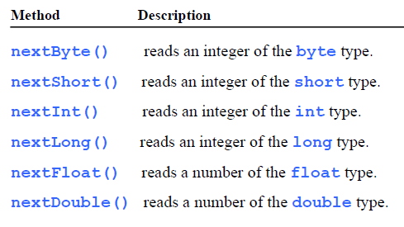
Reading Numbers from the Keyboard
Scanner input = new Scanner(System.in);
int value = input.nextInt();
the method nextInt() reads an integer of the int type and puts it in value.

Slide 4
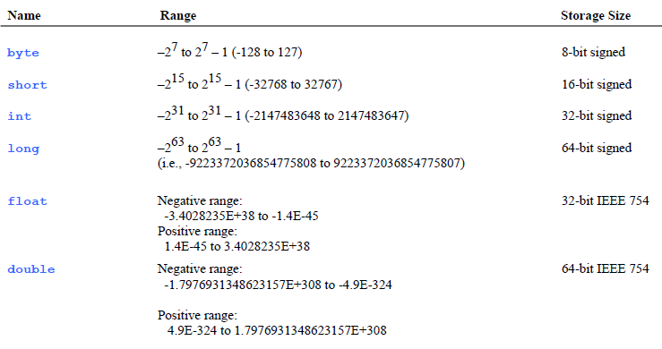
Numerical Data Types

Slide 5
Declaring and Assigning Variables
int x; Declare x to be an integer variable .
int x = 1; Assigning 1 to x.
double radius; Declare radius to be a double variable;
double radius= 1.3; Assigning 1.3 to radius.
char a; Declare a to be a character variable;
char a= ‘A’; Assigning ‘A’ to a.

Slide 6
Declaring a constant
Constants in Java are used when a ‘static‘ value or a permanent value for a variable has to be implemented. Java doesn’t directly support constants. To make any variable a constant, we must use ‘static’ and ‘final’ modifiers in the following manner:
Syntax to assign a constant value in java:
final datatype identifier_name = constant;
ex: final double PI = 3.14159;
The final modifier makes the variable unchangeable.
Capitalize all letters in constants, and use underscores to connect words. For example, the constant PI and MAX_VALUE

Slide 7
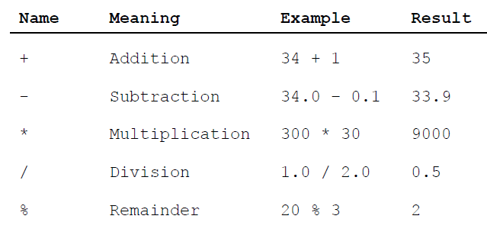
Numeric Operators

Slide 8
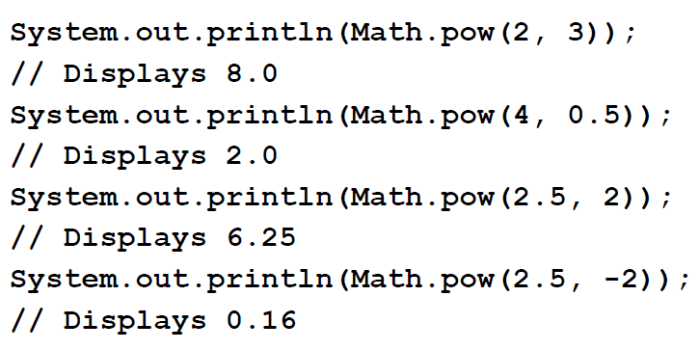
Exponent Operations
Math.pow(x,y) means x to the power y.

Slide 9
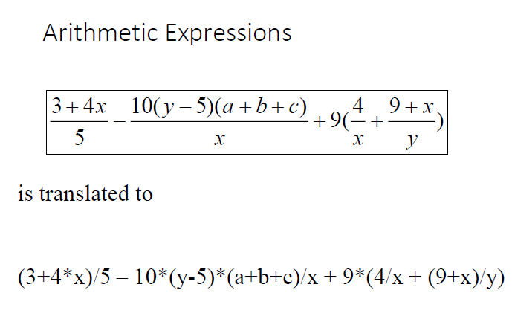
Arithmetic Expressions

Slide 10
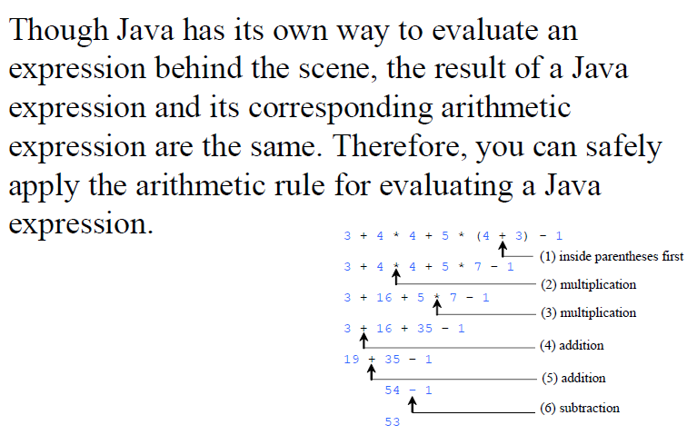
How to Evaluate an Expression

Slide 11
Naming Conventions
☞Choose meaningful and descriptive names.
☞Variables and methods names:
Use lowercase. If the name consists of several words, concatenate all in one, use lowercase for the first word, and capitalize the first letter of each subsequent word in the name. For example, the variables radius and area, and the method cercleArea.
☞Class names:
Capitalize the first letter of each word in the name. For example, the class name ComputeArea.
☞Constants:
Capitalize all letters in constants, and use underscores to connect words. For example, the constant PI and MAX_VALUE

Slide 12
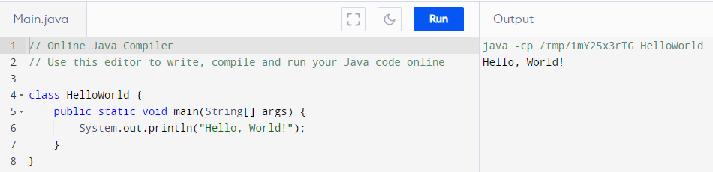
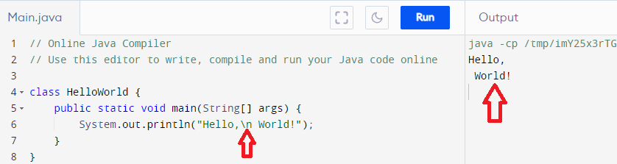
Line Break \n
Without line break
With line break (\n)

Slide 13
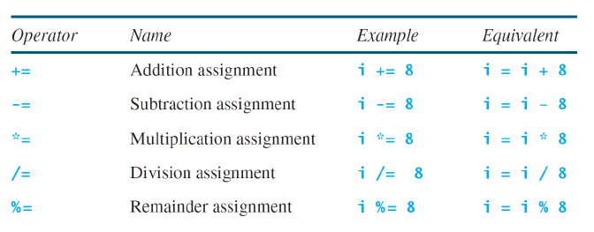
Augmented Assignment Operators

Slide 14
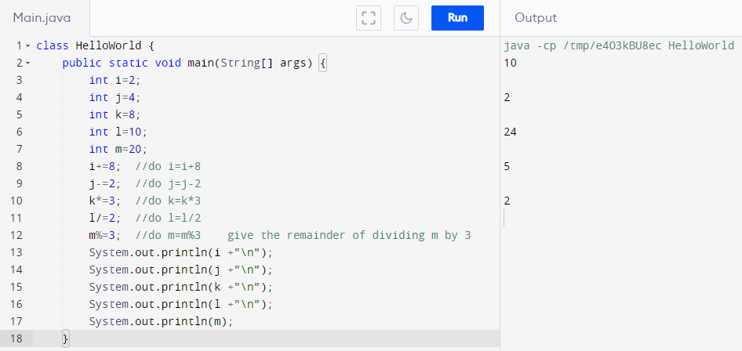
Augmented Assignment Operators Examples

Slide 15
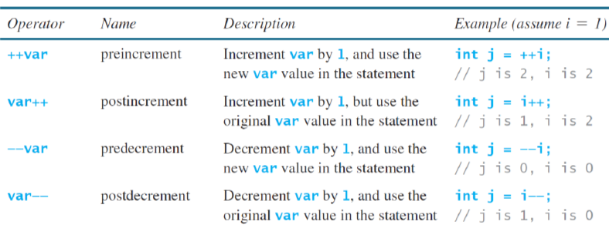
Increment and Decrement Operators

Slide 16
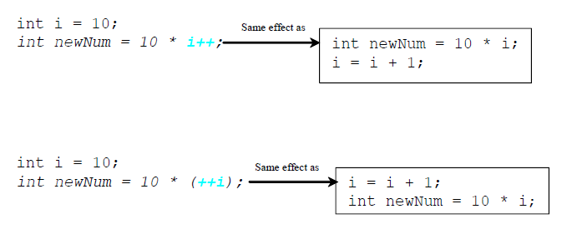
Increment and Decrement Operators, cont.

Slide 17
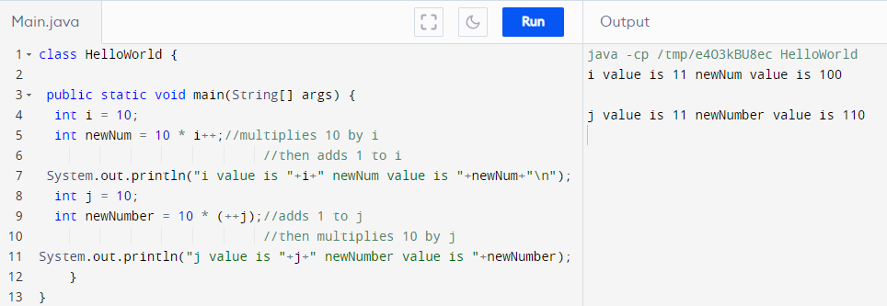
Increment and Decrement Operators Example

